Slide 1
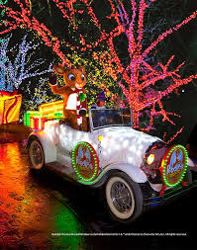
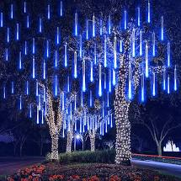
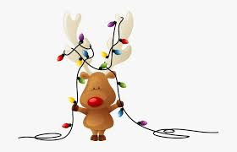
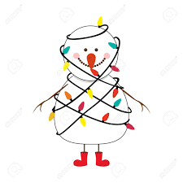
Manalapan Recreation Holiday Drive-Thru!
FM radio station will be provided upon arrival so you can listen to Holiday music as you enjoy the view.
Wishing you a Safe, Healthy and Happy Holiday Season!!
Friday, Saturday and Sunday
December 17, 18 & 19
5:00—7:00 p.m.
(Last car accepted at 6:55 p.m. each night.)
Drive-thru begins at the entrance to the Dreyer Tract within the Manalapan Recreation Center
(enter through the main entrance on Rt. 522; exit through the west lot).

