Slide 1
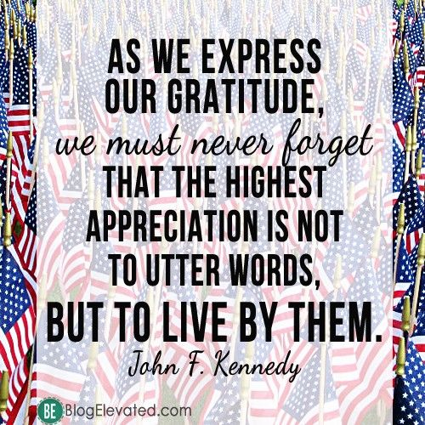
Memorial Day Celebration
Please join us as we honor those brave men and women who have served our country.
Monday, May 31st at 11am at the Veteran’s Walk of Honor at Town Hall

