Slide 1

Manalapan Township
Municipal Operating Budget
A Great Place To Live
Mayor Jack McNaboe
Deputy Mayor Susan Cohen
Committeeman David C. Kane
Committeewoman Mary Ann Musich
Committeeman Kevin Uniglicht

Slide 2
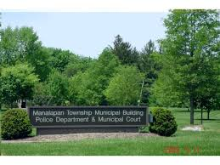
MANALAPAN TOWNSHIP
2018 MUNICIPAL BUDGET
The Township Committee
Continues to Provide
High Quality Municipal Services
to Manalapan Residents while
Minimizing the Financial Impact to the
Township Taxpayers.

Slide 3
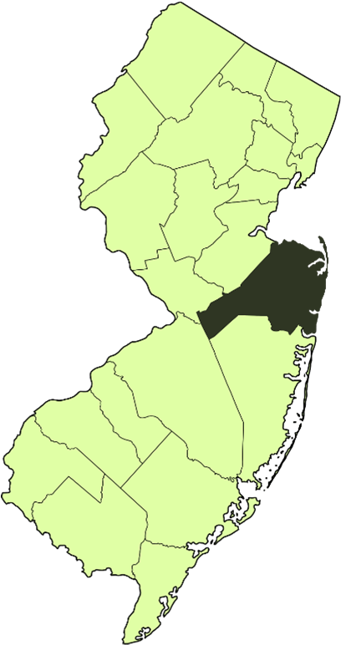
MANALAPAN TOWNSHIP
Located in Monmouth County, New Jersey
Approximately 30.84 square miles
40,169 residents (2015 estimate)
Traversed by US Route 9, State Route 33 with
easy access to the Garden State Parkway,
Interstate 195 and the New Jersey Turnpike.
Located approximately 1 hour from
New York City and Philadelphia.

Slide 4
MANALAPAN TOWNSHIP
2018 Budget Goals
Minimize Current Year Tax Increase
While Maintaining Services Provided
(Garbage Collection, Weekly Recycling, Brush Collection)
Prioritize Spending Reductions to
Minimize Impact on Current Services
Meet State Guidelines on Spending Cap and Levy Cap
Achieve Fiscal Stability by Considering Both the
Short and Longer Term Financial Impact of this
Year’s Budget Decisions.

Slide 5
Moody’s Credit Rating
Moody’s Investors Service upgraded Manalapan rating to Aa1
Great Financial Shape
This upgrade reflects the Townships sizable tax base with moderate new developments, strong healthy indicators, healthy and stable reserve position and low debt burden.
Management and Governance – formal policies on fund balance; responsible budgeting, monthly budget reports to maintain and ensure operations
The township's financial position is expected to remain stable in the near-term due to stable revenue collections and strong spending controls.

Slide 6
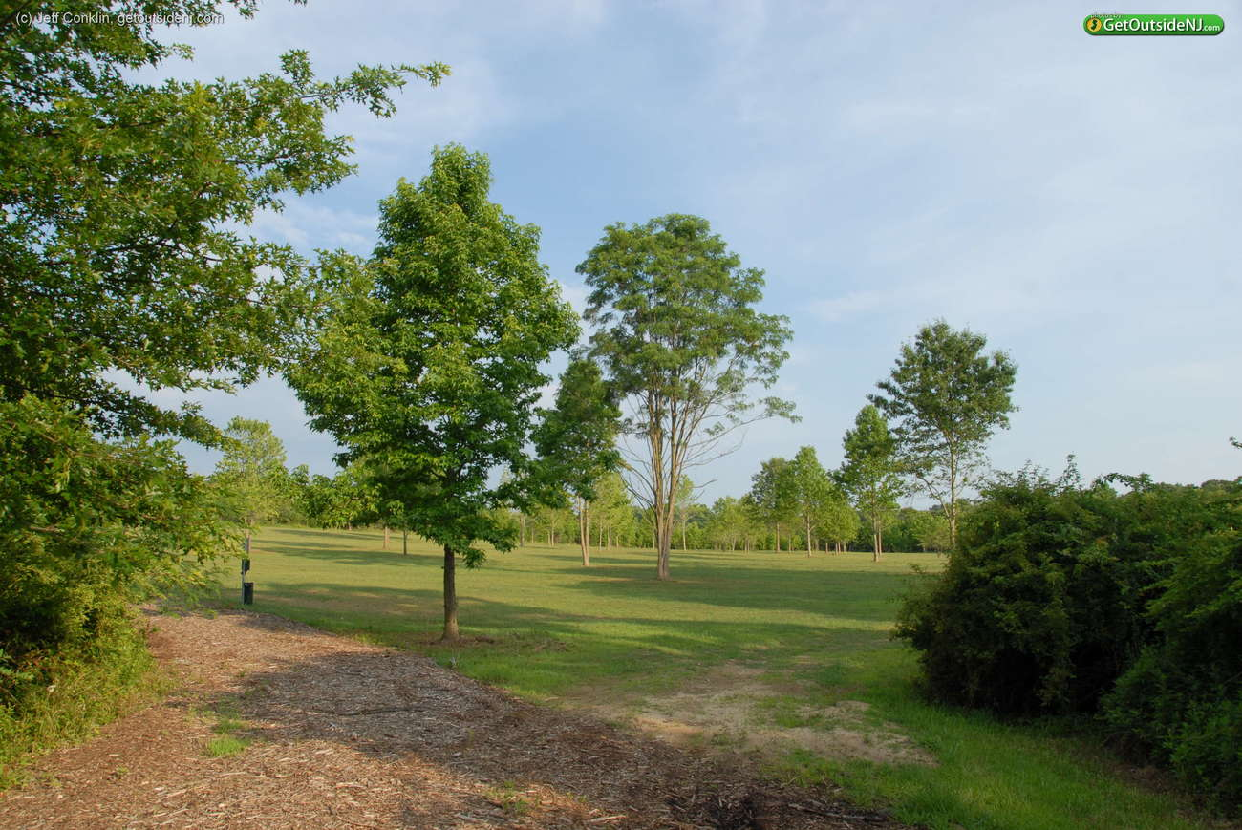
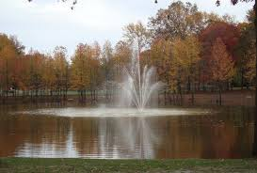
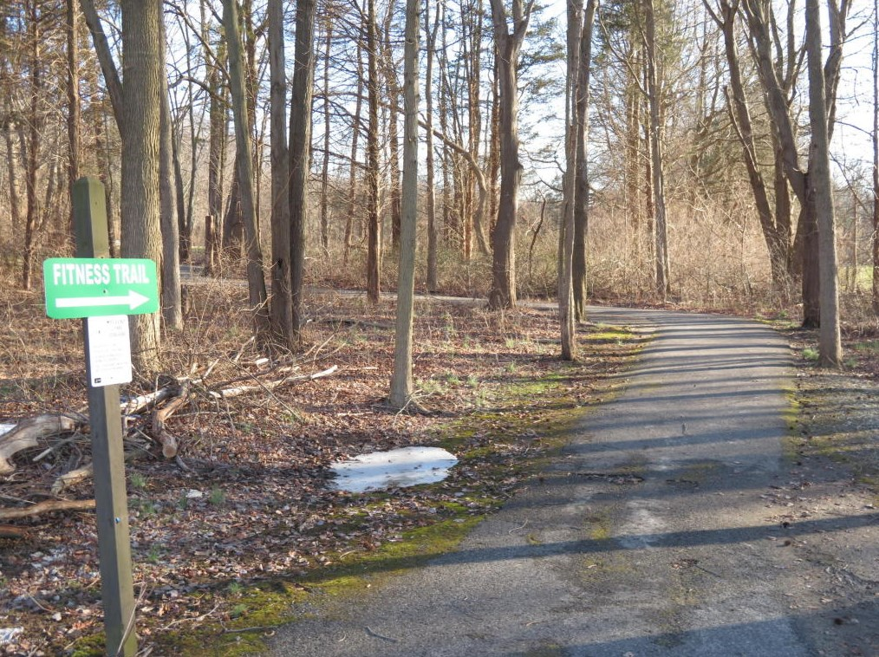
Open Space &
Preserved Property
Monmouth County Park System Open Space Plan
Manalapan Township
2,080 Acres of Open Space
&
1,782 Acres of Green Acres and Farmland Preservation
187 Grants Awarded Since 2003
Total Awarded 28 million
Manalapan Township a Leader
Total Grant Awards
$1,381,000 (7 Projects)

Slide 7

2018 Municipal Budget
Manalapan Municipal Tax Rate for 2018 will be 33.6 cents per $100 of assessed valuation.
This represents a 2.43% tax increase and is below the allowable bank

Slide 8
Household Statistics
Residential - 91.37%
Commercial – 7.42%
  29% of Residents will see no Municipal Tax increase
  33% of Residents will see a Municipal tax increase of $25 of less.

Slide 9
Projected Cost to the Average
Manalapan Homeowner for
All Municipal Services
2018 AVERAGE ASSESSED HOME = $428,076.60 | Annually | Monthly | Weekly | Daily
Total Increase to the Average Assessed Home | $28.19 | $2.35 | $0.54 | $0.08
Total Municipal Taxes on an Average Assessed Home | $1,438.67 | $119.89 | $27.67 | $3.94

Slide 10
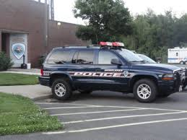
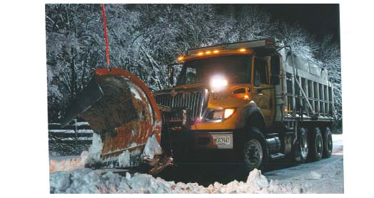
An Average Homeowner pays $119.89 a Month in Municipal Taxes for:
  Public Works
  Road repair
  Snow Removal
Leaf Disposal
  Storm water mgmt and detention basin maintenance
  Park maintenance
  Buildings and grounds maintenance
  Vehicle maintenance
Storm Branch and Brush Removal
  Public Safety
  24 hour police protection
  Emergency Management
  Fire Prevention and Protection
  First Aid - Contribution, Equipment
  Municipal Court
  Trash & Recycling Collection and Disposal
  Twice a Week Garbage Collection
  Every week recycling collection
  Branch and Brush Removal/Bulk Pick-Up
  Code Building, Construction and Land Use Services
    Enforcement
    Planning and Zoning Boards
    Safety Inspections and Proper Permitting

Slide 11
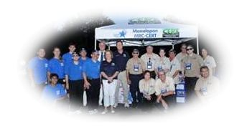
Manalapan Residents Continue to Receive A Vast Array of Services from our Board of Health
Community Emergency Response Team and Medical Reserve Corp
Monitoring and preventing infectious diseases and environmental threats
Blood pressure screening/Senior Wellness Program at various sites in the community
Home nursing services, including primary nursing care and non-primary care
Annual influenza and pneumonia shots
Prenatal health care for pregnant women
Cancer screening services for breast, cervical, colorectal and prostate cancer
Investigation of reportable diseases
Auditing of Pre-School and School student immunization records
Health education programs on a variety of topics
Dog and cat licensing
Licensing and regulation of retail food establishments
Community Alliance – Project Zero
Licensing and regulation of tattoo and body piercing facilities
Licensing and regulation of animal kennels and pet shops
Enforcement of regulations regarding tobacco sales to minors
Licensing and regulation of public recreational bathing facilities

Slide 12
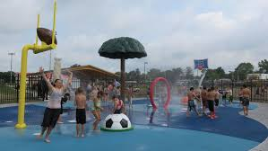
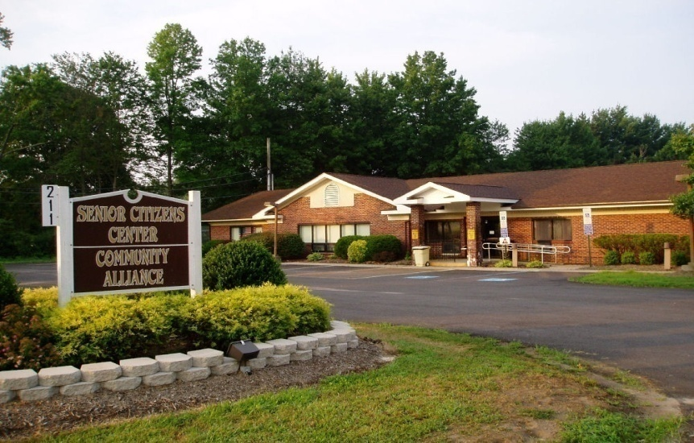
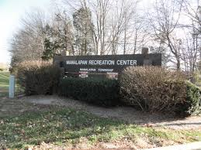
Residents continue to receive the following:
Recreational, Cultural and
Senior Citizen Programming
State of the Art Recreational Facility
Variety of Recreation Programs
Thompson Grove Park
Holiday Lake & Pocket Parks
Splash Park
Dog Park
Early Learning Programs
Summer Concert Series
Community Center
Manalapan Day
Senior Bus Trips
Holiday Events
Exercise Classes
Baby Bundles
Numerous Social Events for Seniors

Slide 13
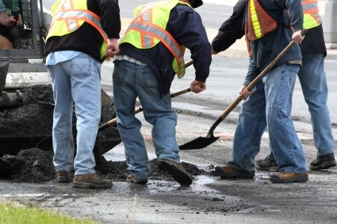
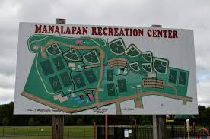
2018 Capital Projects
Road Repaving
  Monmouth Heights Phase 6
  Taylors Mills Road (DOT Grant)
  Gordons Corner Road (DOT Grant)
  Briarheath & Buckshead Devel
  Apache, Devon Dr. N. Miki Terr
  Section of Alexandria Drive
Building and Grounds Projects &
Equipment Purchases
  Pickleball Ct
  Field Renovations
  Basketball/Handball Court Repair
  Police Vehicles
  DPW Equipment
  Salt Conveyor

Slide 14
ESTIMATED TAX RATE
In cents per $100 of Assessed Valuation
 | ESTIMATE 2018 | ACTUAL 2017
REGIONAL ELEMENTARY* | 0.942 | 0.950
REGIONAL HIGH SCHOOL* | 0.410 | 0.418
COUNTY* | 0.287 | 0.292
MUNICIPAL | 0.336 | 0.341
MUNICIPAL OPEN SPACE | 0.020 | 0.020
FIRE DISTRICTS (AVG.) | 0.048 | 0.050
TOTAL | 2.043 | 2.071

Slide 15
Making ‘Cents’ of Your Dollars
Total School Share 65%

Slide 16
2018 SOURCES OF REVENUE
FOR THE MUNICIPAL BUDGET
Revenue Source | Amount | % of Revenue
Amount to be Raised from Taxpayers | $22,354,301 | 66.10%
State Aid | $3,868,653 | 11.44%
Surplus Utilization | $3,665,000 | 10.84%
Local Revenues | $2,232,500 | 6.60%
Delinquent Taxes | $750,000 | 2.22%
UCC Construction Fees | $575,000 | 1.70%
Interlocal Services | $106,373 | 0.31%
Special Items - Fire Safety, Park Improvement | $175,000 | 0.52%
Grants | $90,603 | 0.27%
Total | $33,817,430 | 100.0%

Slide 17
HOW MUCH DOES EACH DEPARTMENT COST?
DEPARTMENT | 2018 S&W | 2018 O.E. | 2018 TOTAL | % OF BUDGET
PUBLIC SAFETY | $7,906,500 | $366,901 | $8,273,401 | 24.46%
INSURANCE | $105,750 | $4,620,764 | $4,726,514 | 13.98%
UTILITIES, SANITATION, LANDFILL & RECYCLING | - | $4,521,000 | $4,521,000 | 13.37%
PUBLIC WORKS & PARKS MAINTENANCE | $2,022,525 | $1,099,850 | $3,122,375 | 9.23%
STATUTORY EXPENSES | - | $3,331,305 | $3,331,305 | 9.85%
DEBT SERVICE | - | $2,688,572 | $2,688,572 | 7.95%
RESERVE FOR UNCOLLECTED TAXES | - | $2,430,596 | $2,430,596 | 7.19%
GENERAL GOVERNMENT | $1,253,296 | $625,110 | $1,878,406 | 5.55%
CONSTRUCTION DEPARTMENT/LAND USE | $903,300 | $92,300 | $995,600 | 2.94%
INTERLOCAL / SHARED SERVICE AGREEMENTS | $73,673 | $500,870 | $574,543 | 1.70%
PARKS & RECREATION | $410,000 | $106,165 | $516,165 | 1.53%
HEALTH & HUMAN SERVICES | $370,750 | $47,600 | $418,350 | 1.24%
CAPITAL IMPROVEMENT FUND | - | $175,000 | $175,000 | 0.52%
RESERVE FOR TAX APPEALS |  | $75,000 | $75,000 | 0.22%
STATE & FEDERAL GRANTS | - | $90,603 | $90,903 | 0.27%
TOTAL | $13,045,794 | $20,771,635 | $33,817,429 | 100.00%

Slide 18
Where Does It Go?
$1,438.67
Public Safety: $352.91
Insurance/Statutory: $201.62
Utilities, Sanitation & Recycling: $192.85
Public Works & Parks Maintenance: $133.19
Statutory Expenditures: $142.10
Capital Projects/Debt: $114.69
Uncollected Taxes: $103.68
General Government: $ 80.13
Construction/Land Use: $ 42.47
Shared Services: $ 24.51
Parks & Recreation: $ 22.02
Health & Human Services: $ 17.85
Capital Improvement Fund: $ 7.46
Reserve for Tax Appeals: $ 3.20

Slide 19
Manalapan Township
A Great Place To Live
Public Hearing 2018 Budget
Mayor Jack McNaboe
Deputy Mayor Susan Cohen
Committeeman David C. Kane
Committeewoman Mary Ann Musich
Committeeman Kevin Uniglicht

